Slide 1
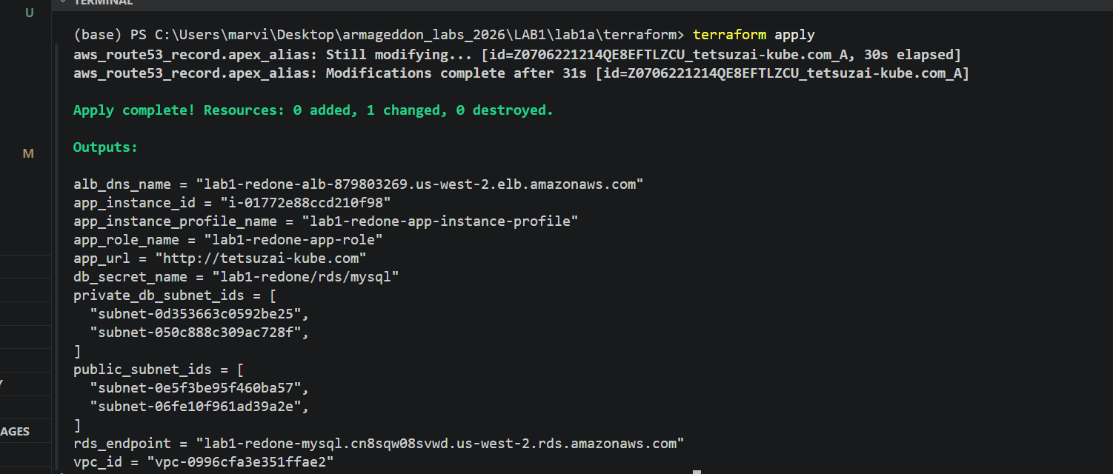

Slide 2
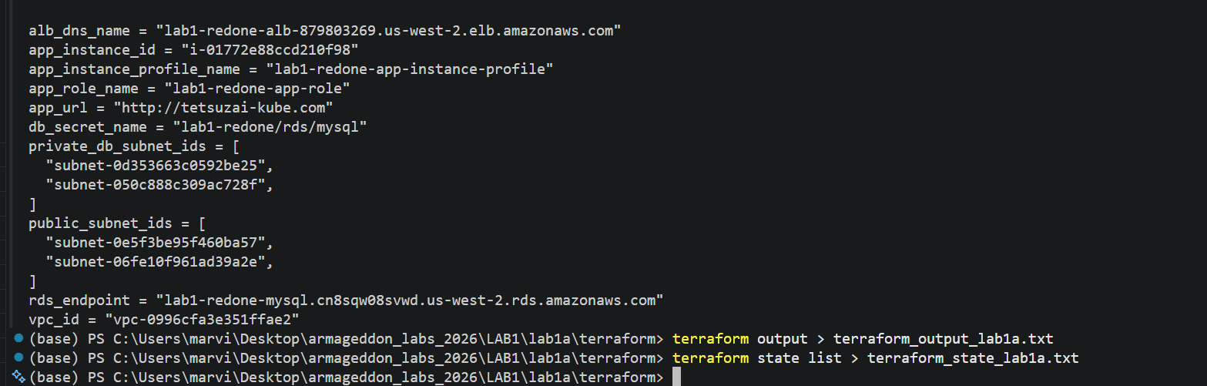

Slide 3
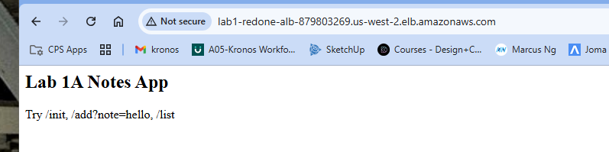

Slide 4
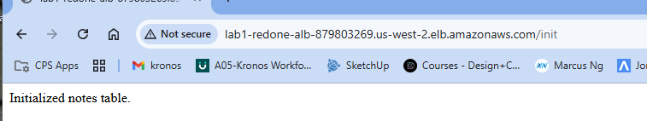
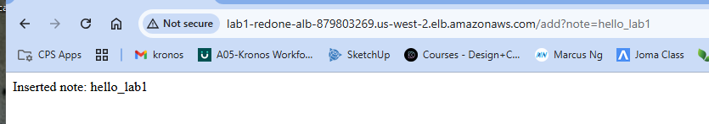
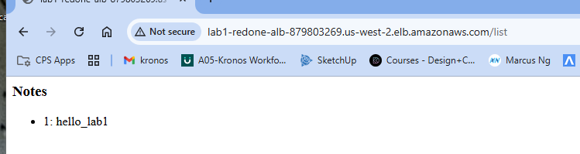
Testing the ALB directly
http://lab1-redone-alb-879803269.us-west-2.elb.amazonaws.com/init
http://lab1-redone-alb-879803269.us-west-2.elb.amazonaws.com/add?note=hello_lab1
http://lab1-redone-alb-879803269.us-west-2.elb.amazonaws.com/list

Slide 5
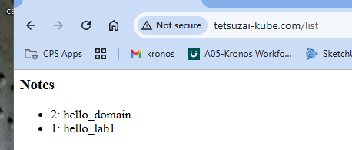
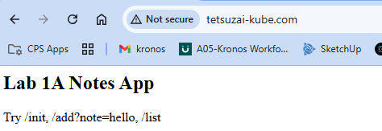
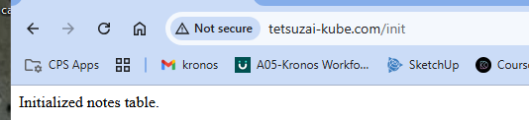
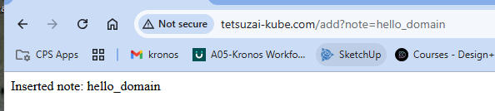
http://tetsuzai-kube.com
http://tetsuzai-kube.com/init
http://tetsuzai-kube.com/add?note=hello_domain
http://tetsuzai-kube.com/list
testing the domain

Slide 6
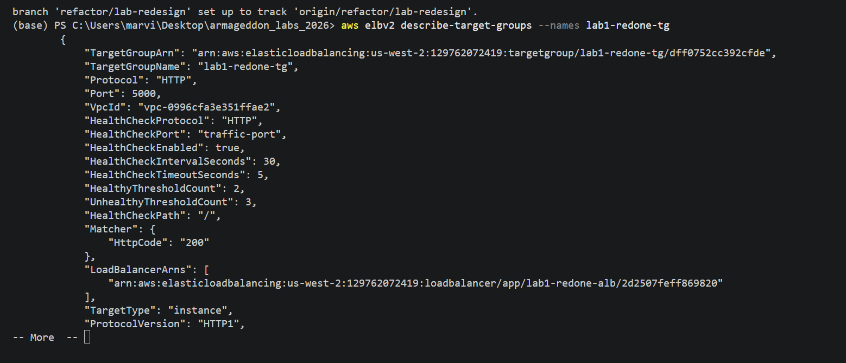
Fast AWS checks

Slide 7
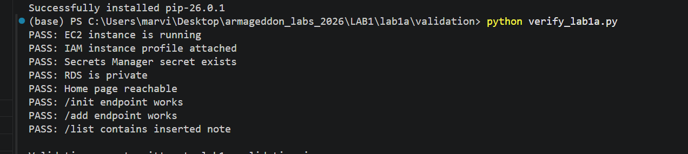
PYTHON EVIDENCE….

Slide 8
